Slide 1
Deep Learning Dynamos
Gema Csanád

Slide 2
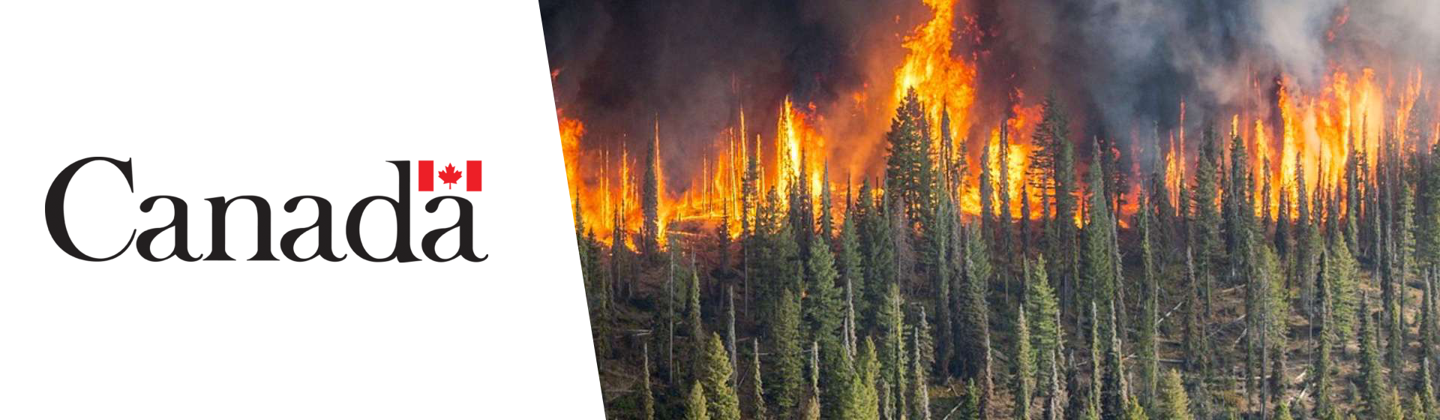
Topic: Wildfire Detection Using Satellite Images

Slide 3
Autonomous Satellite Wildfire Detection Using Hyperspectral Imagery and Neural Networks:
Hyperspectral Imagery
1D-CNN
Real-time analysis
Deployed in Australia
Source

Slide 4
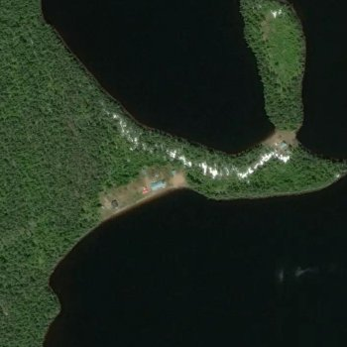
Data exploration
Kaggle
Wildfire : 22710 images
No wildfire : 20140 images
70/15/15

Slide 5
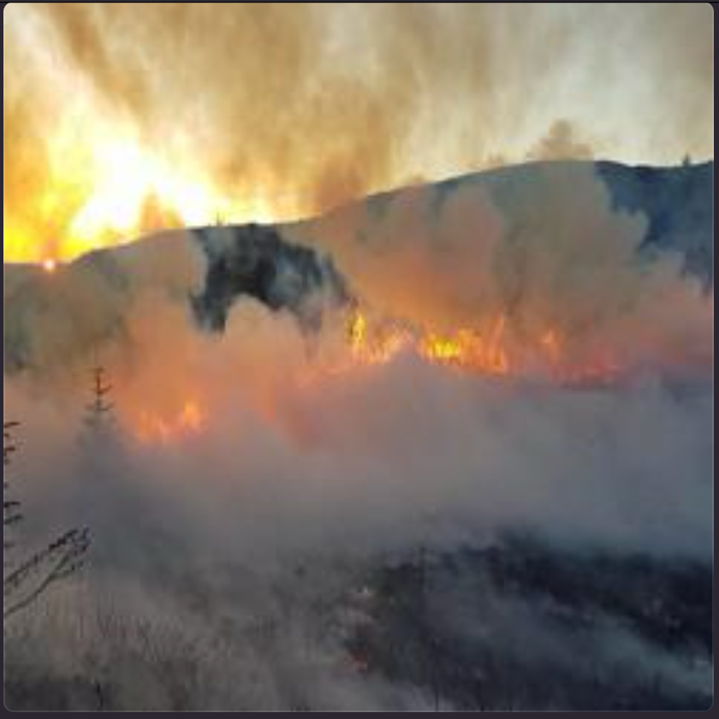
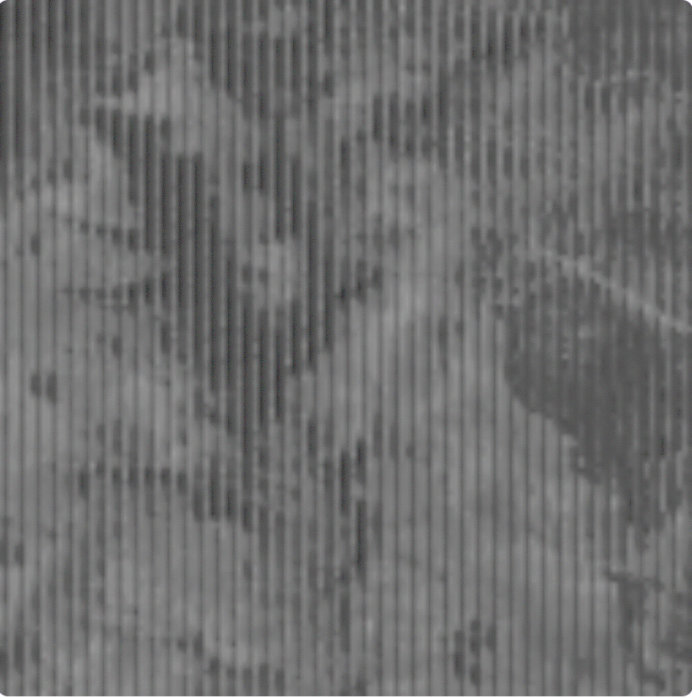
Other Datasets

Slide 6
Data Cleansing
Clean data
Evenly distributed classes

Slide 7
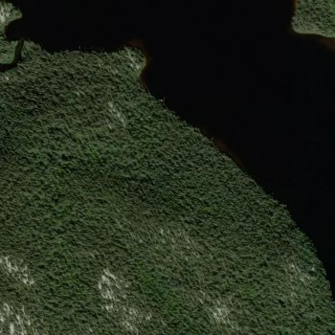
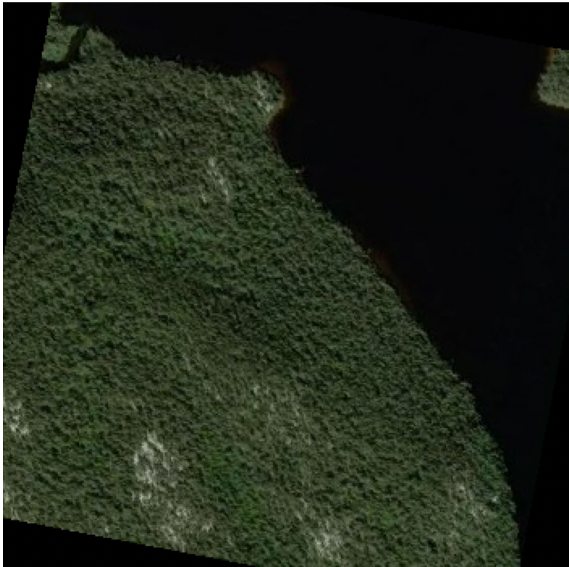
Data augmentation
Original
Rotation (±30°)

Slide 8
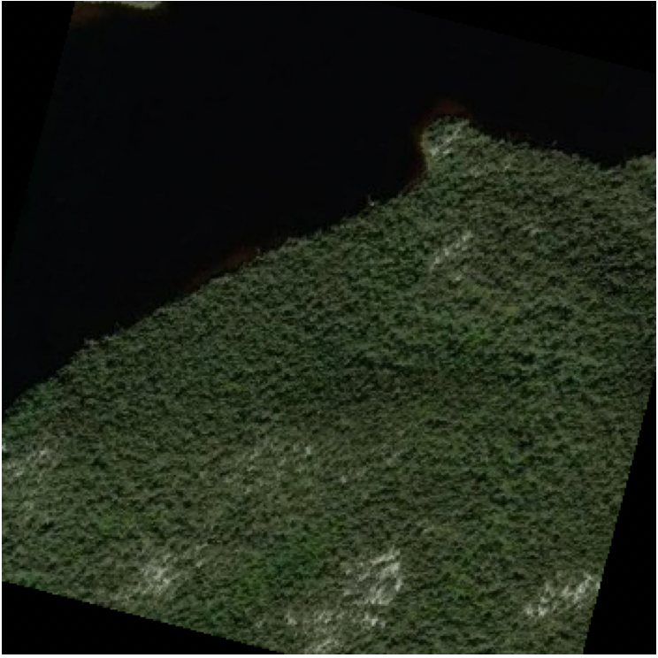
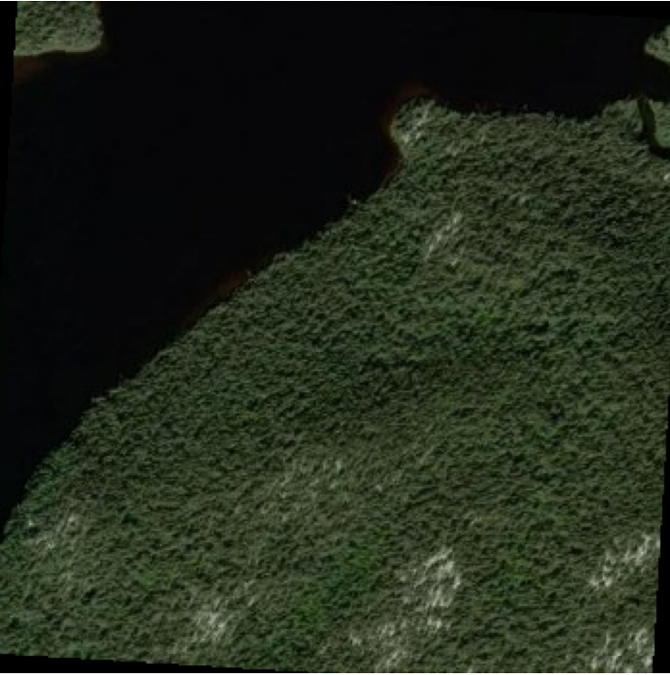
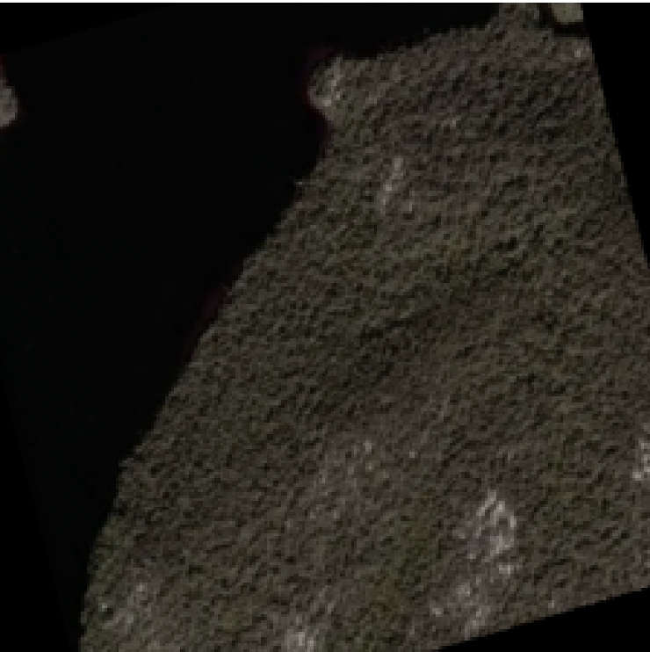
Data augmentation
Random Horizontal
Flipping
Random Resized
Crop
Colour Adjustments

Slide 9
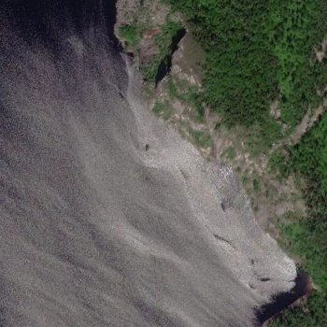
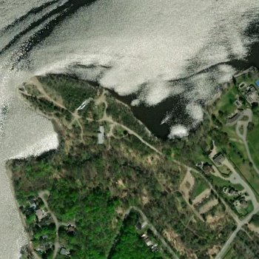
Challanges
Smoke
Cloud

